Slide 1
Taking a co-production approach to evaluating services at Scope
Presentation to ChEW, February 2021

Slide 2
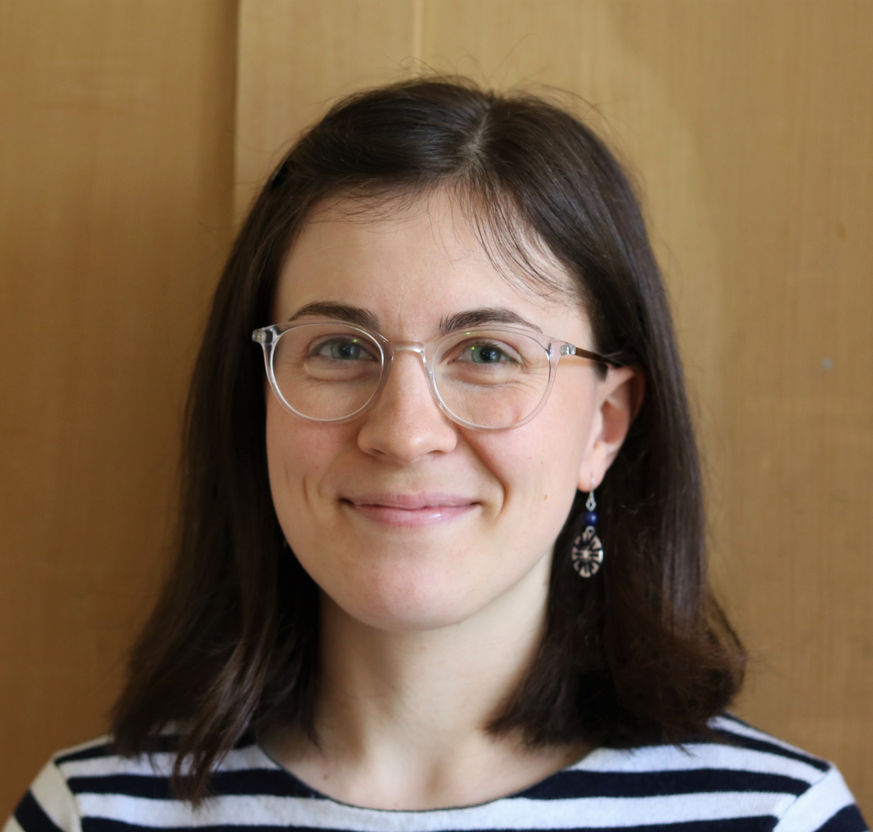
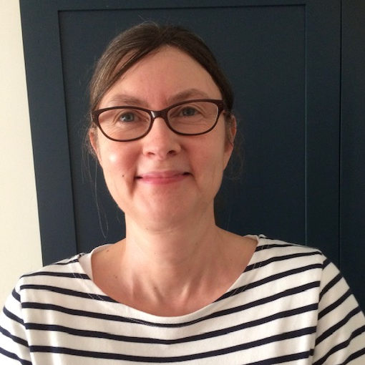
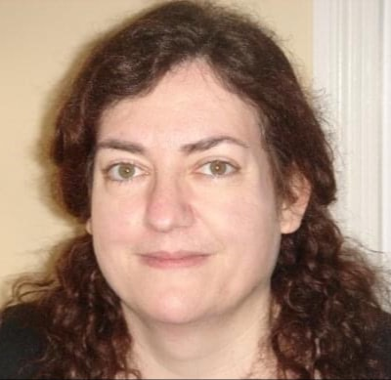
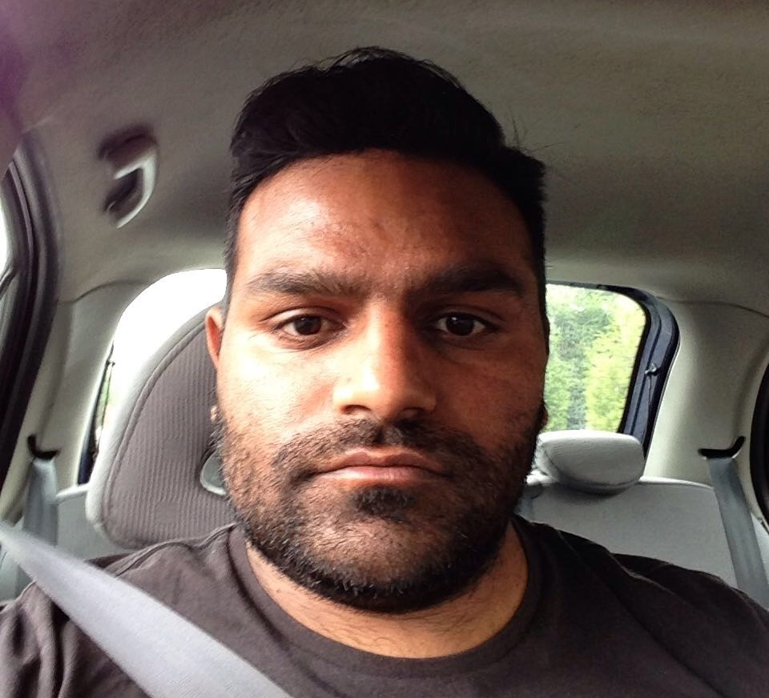
Who are we?
Jess Bricknell
Evaluation Officer
Julie Hartley
Peer Reviewer
Ruth Murran
Co-Evaluator
Mustak Patas
Customer Representative
Not here today:
Amy Frounks, Co-Evaluator
Nathan Giles, Peer Reviewer

Slide 3

Introduction to Scope
Scope = Equality for disabled people
Provide practical information and emotional support.
Campaign to create a fairer society.
In 2017 we launched our five-year strategy, Everyday Equality, focused on:
  Children and families Independent living Financial security
With the new strategy came new research, new campaigns and new services.
New need for an evaluation function

Slide 4

What we mean by co-production
Doing with, not doing for
Actively considering disabled people and their families as partners from the very beginning through to the end of a project or activity
Entering into an equal and reciprocal relationship where decisions and responsibilities are shared
Valuing lived experience and recognising its importance in developing effective products and services

Slide 5

Why co-production in evaluation?
Evaluation involves making assessments of value and effectiveness.
Co-production ensures that a wide range of stakeholders participate in how that value is defined, measured and interpreted. That means a fairer and fuller evaluation.
Evaluation is used a tool to inform future activities.
Co-production means that the people most affected by services or policies are involved in drawing conclusions from evidence and forming recommendations. That leads to better tailored practice.

Slide 6

The Support to Work service
Scope’s online and telephone support programme for disabled people looking for paid employment.
Operates across England and Wales
12 week programme of 1 to 1 support with an assigned adviser
Sits alongside Scope’s other employment services, which operate locally and face-to-face with people experiencing more significant barriers to employment.

Slide 7
Getting the project off the ground

Slide 8

Making the case
Leadership buy-in is crucial.
Seek out and approach open minded leaders and funders.
Try to build understanding of co-production as a mindset rather than a fixed process.
Highlight the strategic and financial benefits: better tailored services.
Use external case studies.
Some activities may present more opportunities for co-production than others (how projects are run, who they are funded by, and for how long)
Where do you have the room to push for this approach?

Slide 9
Why Support to Work?
Feature of Support to Work | So what?
National service | Large reach; potential to affect a lot of disabled people. Need for robust evaluation.
Relatively new but relatively stable service | Appetite to learn and improve, but some established structure to investigate.
Funded by corporate partner | Openness to different ways of defining impact and supportive of co-production principles.
Employment-focussed | Opportunity to generate supporting evidence for strategic campaigning goals.

Slide 10

How do you co-produce an evaluation?!
Where I started:
Disabled People’s Organisations
Researchers with lived experience
INVOLVE (National Institute for Health Research)
Co-Production Network for Wales Knowledge Base
Rethink (mental health charity)
St. Mungo’s (homelessness charity)
Academic papers
DRILL Programme
Read about how others have done it
Spoke to our Engagement and Participation Lead (role supporting engagement with disabled people)
Spoke to researchers who had done it
Read about the experiences of people who have been involved as peer researchers

Slide 11

How do you co-produce an evaluation?!
What this gave me:
Building and maintaining reciprocal relationships
Sharing power, roles and responsibility
Capacity building
Flexibility
Reflection
A set of values and principles which underpinned the whole project
An understanding of the evolving nature of co-produced research
Awareness that this project would take time.

Slide 12

With these values and principles in mind:
Reflected on key stakeholders.
Who has an interest in Support to Work?
Who should be involved in evaluating it?
Spoke to the relevant budget holder.
Proposed a structure and timeline for the project.
Wrote a budget, thinking especially about:
Stakeholder time
Reasonable adjustments
Travel
Got sign-off!

Slide 13
Key Stakeholders
Internal:
Support to Work Programme Lead
Support to Work Employment Advisor Programme Architect (service designer)
Research Manager
Policy Advisor
External:
Customers
People with lived experience of disability
Funder representative
Disabled People’s Organisation representative
Two structures:
  Co-evaluation team
  Stakeholder panel

Slide 14
Co-evaluation team
A research team with lived experience of disability.
Aimed for six people; recruited five
Had input to every step of the evaluation
Variety of roles to encourage accessibility and diversity of process
Positions advertised online with role profiles and project information*
*Online recruitment may not always be the most appropriate method for recruiting or inviting participation.
Evaluation Officer
Two Co-Evaluators
Two Peer Reviewers
One Customer Representative

Slide 15


Key Stakeholder Panel
An engaged group of people interested in the evaluation.
Higher-level steering capacity
Helped set the key evaluation priorities
Targeted letters of invitation to external stakeholders
Terms of Reference important for mutual understanding
Agreed responsibilities and remuneration from outset
Helped guide and carry out final dissemination

Slide 16
What did taking a co-production approach look like in practice?

Slide 17

Training of co-evaluation team
Training content:
Types of data sources
Qualitative research basics
Interviewing and focus group skills
Qualitative data analysis
Formal face to face training sessions
Sharing reading materials
Role play during workshops
Shadowing Scope researchers
Sharing examples of past Scope research as an illustration of potential methods and outputs

Slide 18
How the team interacted
“The structure of my role enabled me to participate. I could work remotely and be flexible in organising my tasks. […] These factors make all the difference in enabling disabled people to participate in co-production.”
Regular whole team video catch-ups
Ongoing support through individual video catch-ups and general line management.
Factors affecting team functioning
Multiple project roles offering various levels of involvement.
Project methods or stages should be conducted in accessible ways to enable each individual contributor to participate as part of the team.
Frequency (but also flexibility) of communication.
Outside circumstances

Slide 19

Analysis
All of the co-evaluation team had access to the research data
Each transcript coded by multiple team members
Reflected on data both individually and in team discussions
Allowed a deep interrogation of patterns and meaning in the data
This exposed any differences in individual interpretations
Shared agreement on findings and conclusions
Report writing shared across the team

Slide 20

What we learned along the way
Relationships and communication are key!
In order to share thoughts and opinions freely, we need to feel mutual trust and respect. This only comes with time.
Frequent team meetings are important for building and maintaining effective collaboration.
“The long timescale and stop-start progression of the project meant that it could be hard to maintain momentum and keep in touch. Regular remote team meetings later in the process helped with this.”

Slide 21
What was the impact of taking a co-production approach?

Slide 22
Impact on the evaluation
“[The] team allowed me to speak freely in an atmosphere of trust and respect”
Participant experience
Depth of analysis: collaborative, iterative process
Quality of recommendations
Increased focus on how past experiences influence the way customers feel and behave when interacting with the service
Depth of stakeholder engagement and understanding
“It felt like I was being heard and understood”

Slide 23

Impact on service
Highly contextualised recommendations helped the service decision-makers to understand the basis for suggestions. As a result:
Introduction of in-work support: funding agreed with engaged panel stakeholder
Service promotion updated to incorporate language and service features that customers particularly value
Service now follows up with all customers leaving the service, not just those entering work
“I think that a co-produced research project […] provides a unique opportunity for organisations to shape services in a way that makes a meaningful impact on the lives of their service users.”
– Nathan, Peer Reviewer

Slide 24

Impact for individuals involved
How it started
Employment Support Allowance – 7 months
Job Seekers Allowance
Universal Credit
Psychosis Intervention and Early Recovery team service user
How it’s going
Started full-time work in September 2020
Employed as a Picker for Co-Operative, Leicester on a permanent contract
Community Mental Health Team service user
“I was worried about the judgement of others and how I would be viewed […] I rely heavily on email communication and it’s taken over my life. When I spoke to colleagues at Scope I realised that I was valued and the team made me feel like a person. […] Being part of a group meant I was recognised and appreciated by other members and this was a serious motivator to complete the project.”

Slide 25

Impact on Scope
Proof that engaging with stakeholders with lived experience can:
Identify and articulate unmet needs
Help stakeholders understand the context of need, and why certain improvements are appropriate
Create new ways of defining impact, beyond hard outcomes
Improve relationships with a range of stakeholders
Generate new funding

Slide 26
Co-Production at Scope
Evolution from engagement and participation to co-production
2017: Engagement and Participation Strategy launched
2019: First projects taking an explicitly co-produced approach
2020: Co-production officially adopted as strategic operational aim by Board and Senior Leadership
2021: org-wide programme to raise awareness of co-production and facilitate its application, through:
    training
    budgeting support
    recruiting co-production champions
    targeted events and internal publications

Slide 27
Thank you!
Questions? jessica.bricknell@scope.org.uk

